Slide 1

HR Attrition Project
Data Science Institute PgDip
Gary Schulze

Slide 2



Introduction
The most important aspect for any organisation is its employees. Employees, and especially those who have more experience and a higher skillset, offer the organisation the most value.
Most organisation’s HR departments work on trying to retain that experience and skill. It has become increasingly important for such departments to gain insight into attrition and gain a better understanding of why staff leave and what may be done to help prevent it in the future.

Slide 3

Consequences of high attrition
Employee retention is important for several reasons.
High attrition can be time consuming and costly. Every recruit needs their CV reviewed, be screened, have an interview. Once they are employed, they will require onboarding and training. When staff leave, there is exit interviews and paperwork. This may also reduce productivity whilst looking for a replacement.
An organisation with high retention is likely to attract and retain more qualified talent. This has to do with reputation relating to employee satisfaction and morale. This can be very appealing to someone looking for a new job. Retention also enhances employee experience and skill.
Consistent changes in staff make it more difficult for employees to develop positive working relationships with their fellow employees. Employees who stay at a company for longer are often less stressed and more committed to the long-term success of the organisation. They also tend to more productive having more pride, loyalty and a sense of belonging.

Slide 4
Phase 1- Data management
Load data
Acquire and load data sets
Clean
Explore the data sets, understanding the structure, checking for duplicate records
Merge
Merge the data sets into one master file. Create new fields where required to simplify the output.
Explore
Explore the data set. Check for outliers and missing values. Remove or impute missing values. Convert data type as required.
Complete
Generate initial graphs and preliminary analysis before moving onto phase 2.

Slide 5
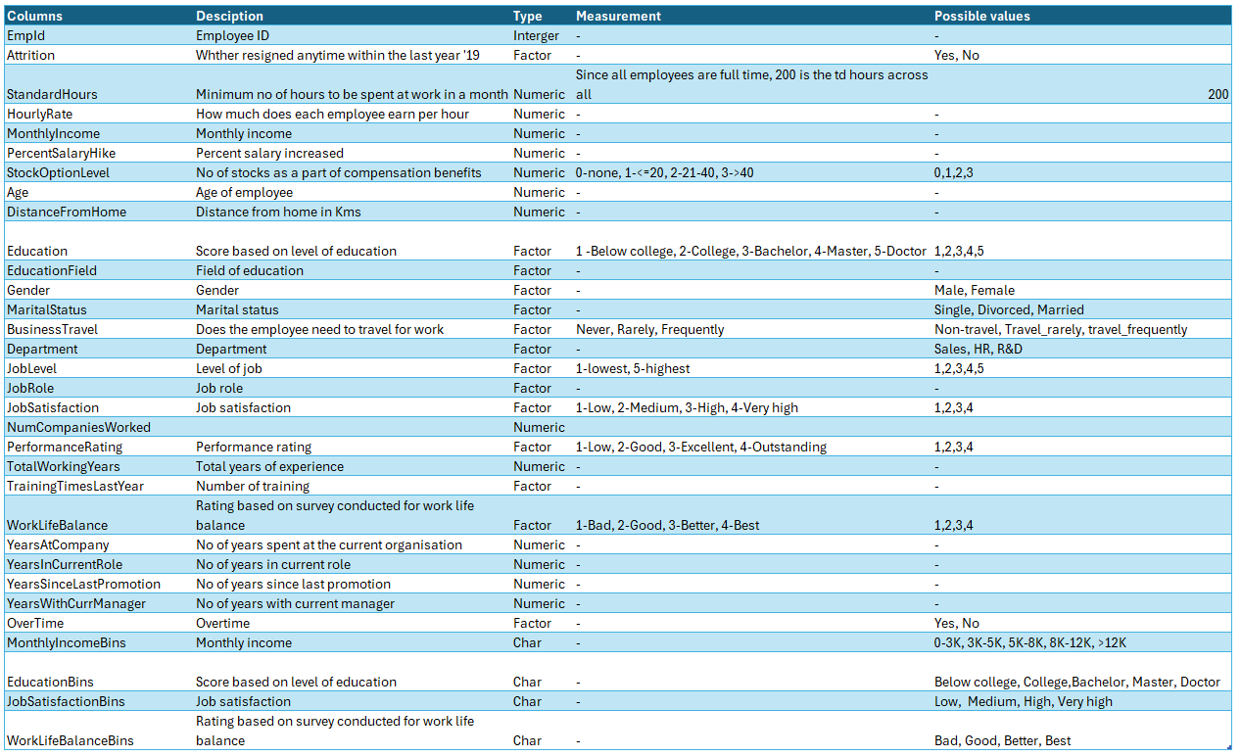
Data Snapshot
Once all data sets are merged, cleaned and additional columns added, there is a total of 1470 rows and 32 columns.

Slide 6
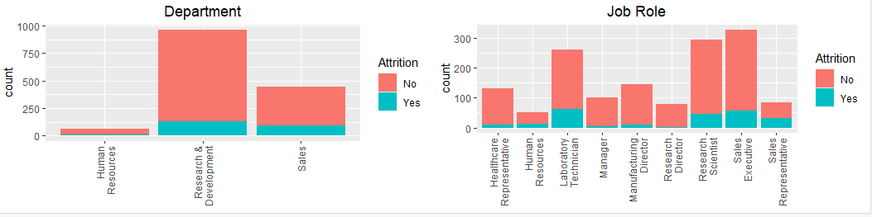
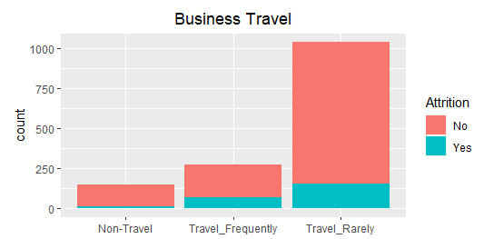
Visualize – Initial interpretation
Overall, attrition appears to be low.
Research and Development has the most attrition amongst the departments, although Sales will have a higher attrition rate.
In Job role, Laboratory Technician and Sales executives have the most attrition, although as a proportion of the overall in each role, their attrition rate is low.
Business travel seems to have an impact on attrition, with those that travel rarely having the lowest attrition rate.

Slide 7
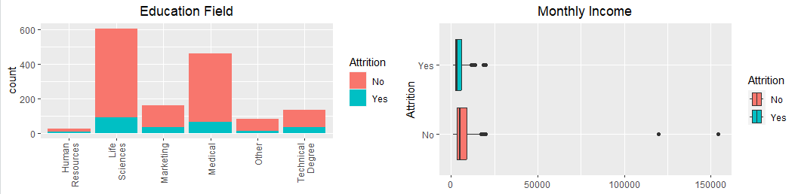
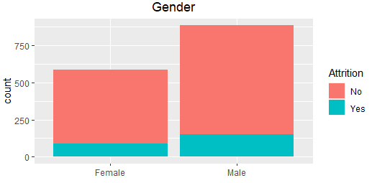
Visualize – Initial interpretation
Overall, attrition appears to be low.
Females tend to have a lower attrition rate
Monthly income attrition seems to be lower when the income is higher, although, there are outliers that need to be removed.
Human resources appear have the lowest attrition in terms of education field.

Slide 8
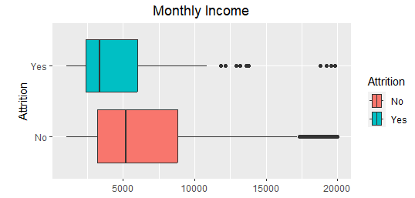
Visualize – initial interpretation
With some of the outliers removed, it is clearer that higher income earners have lower attrition.

Slide 9
Phase 2 – Descriptive statistics and data visualization
Box whisker plots
Create plots
Attrition rate
Calculate the attritions rates, tabulate and visualise.
Mean
Calculate mean and median
Heatmap
Generate heatmap for attrition rates
Complete
Moving onto phase 3.

Slide 10
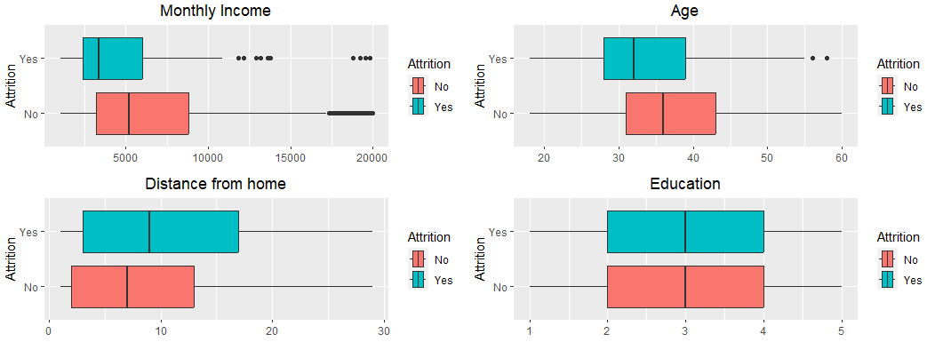
Visualize – Box Whisker plots
Higher monthly income tends to result in lower attrition.
The greater the distance from home, the higher the attrition rate.
Age tends to indicate that younger people are more likely to leave the organisation.
Education appears to have no impact on attrition.

Slide 11
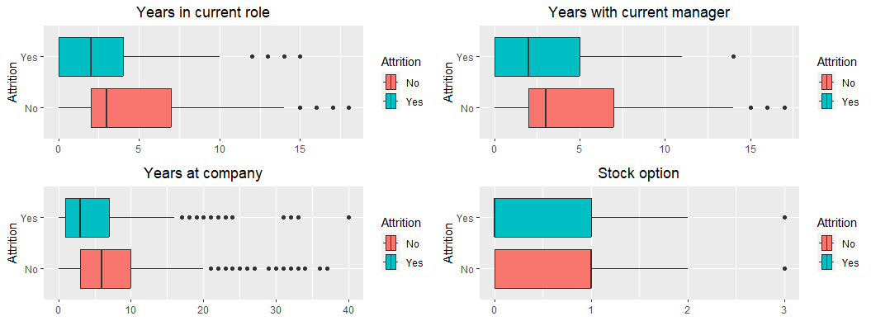
Visualize – Box Whisker plots
More years in their current role tends to have lower attrition.
More years at the organisation also tends to have lower attrition.
More years with their current manager tends to have lower attrition.
Stock options does not seem to have an impact on attrition.

Slide 12
Attrition rate tables
Overall attrition rate is 16%.

Slide 13
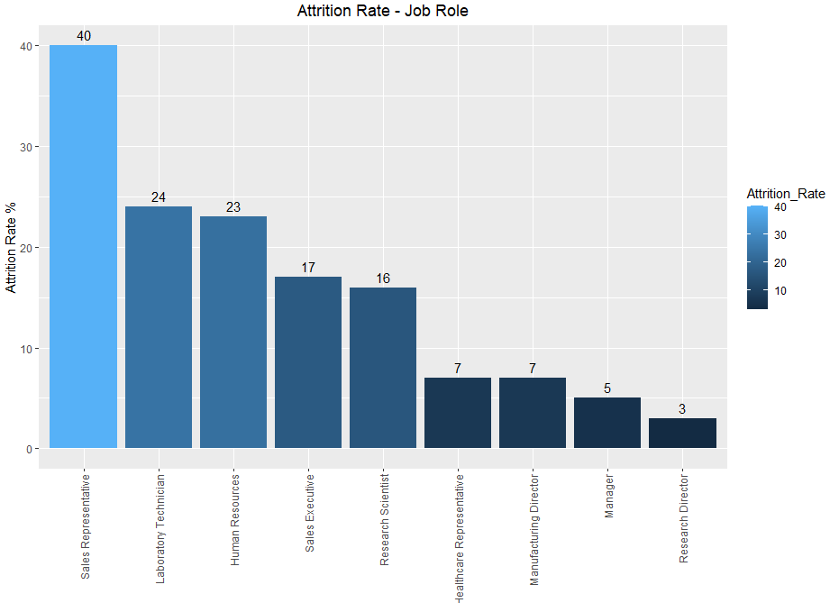
Attrition rate – Analysis by Job role
Within the job role category, Sales executives have the highest attrition rate.
It would be useful to understand if there are any trends for sales representatives that may be driving the high attrition, for example, monthly income, work life balance, overtime or job satisfaction.

Slide 14
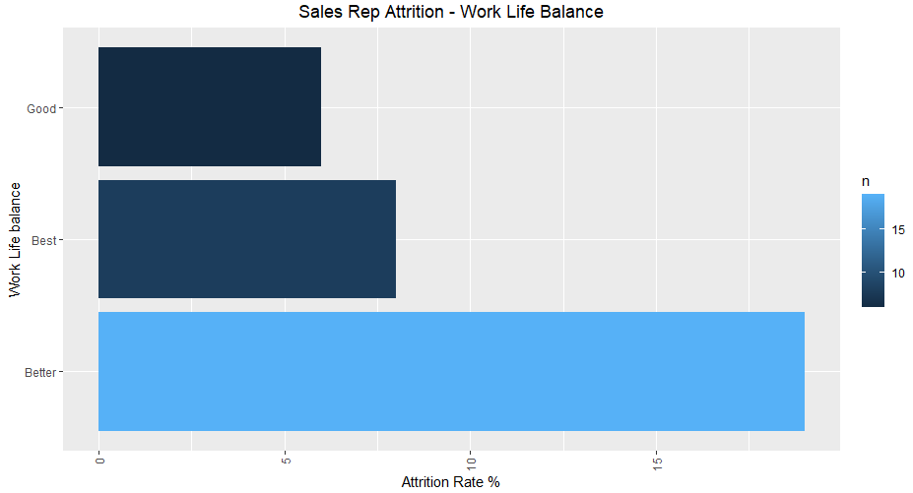
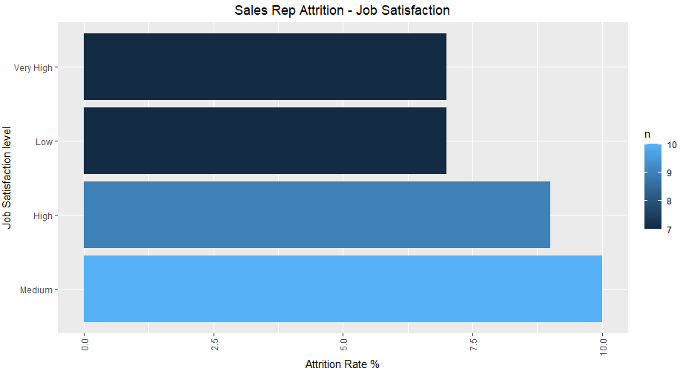
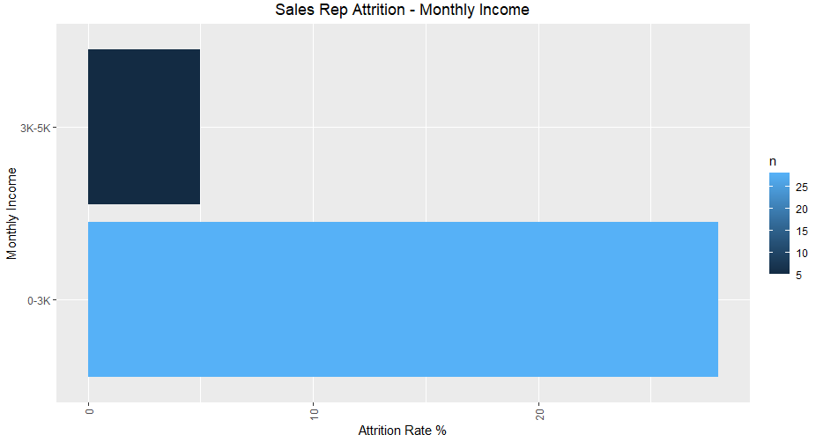
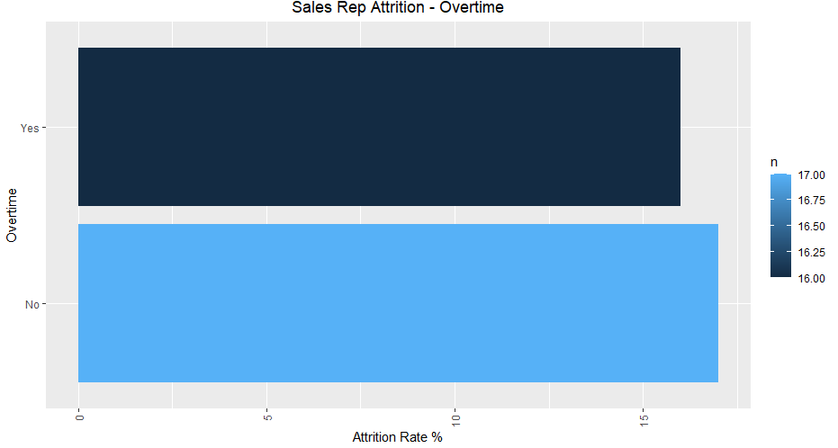
Attrition rate – Job role
From the visuals, we can clearly identify that monthly income is the reason that the sales representatives leave the organisation.
Work life balance, job satisfaction and overtime do not seem to impact attrition much at all.

Slide 15
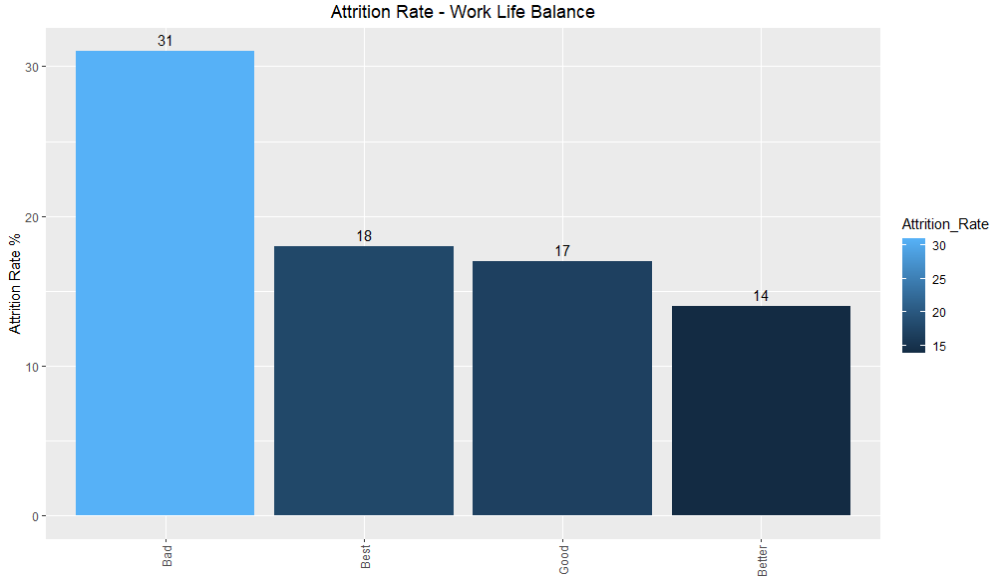
Attrition rate – Work Life Balance
The attrition rate when looking at work life balance, indicates a high attrition rate for bad work life balance.
This is something that may well drive people to leave as working from home has become common place since the pandemic.
We can investigate this by further by filtering the data by Job Role to identify which job roles may be more likely to leave.

Slide 16
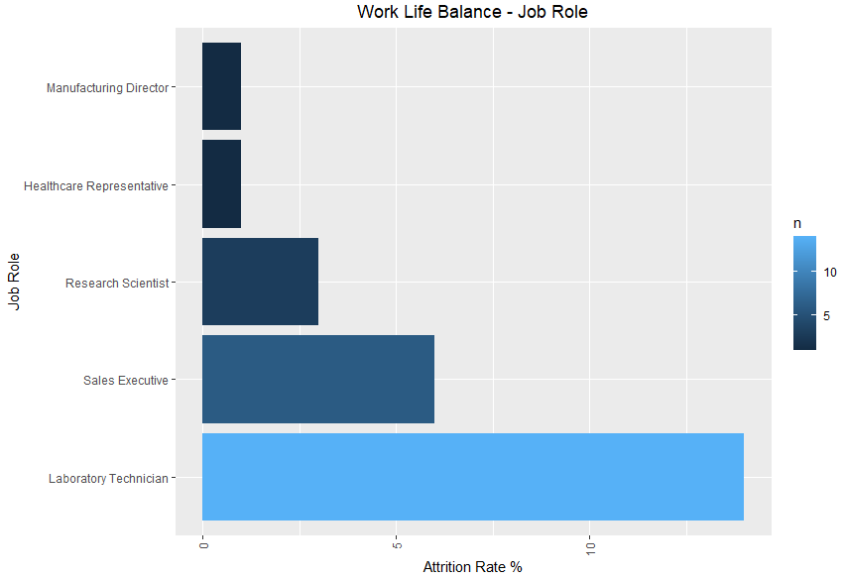
Attrition rate – Work Life Balance – Job Role
The attrition rate when looking at work life balance by job role, indicates that Laboratory Technicians have the highest attrition rate.
We can investigate this by further by filtering the data by Laboratory Technician to gain better insight into why they may be leaving.

Slide 17
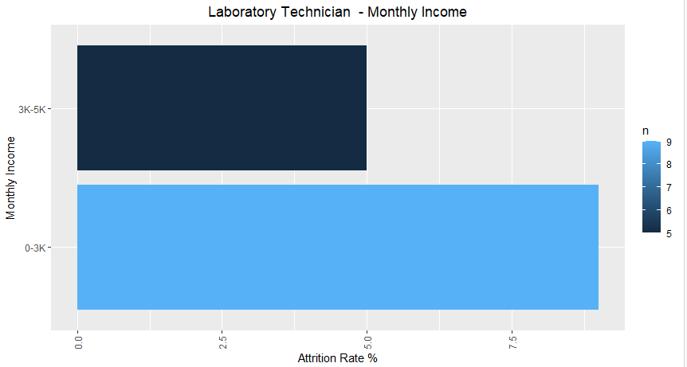
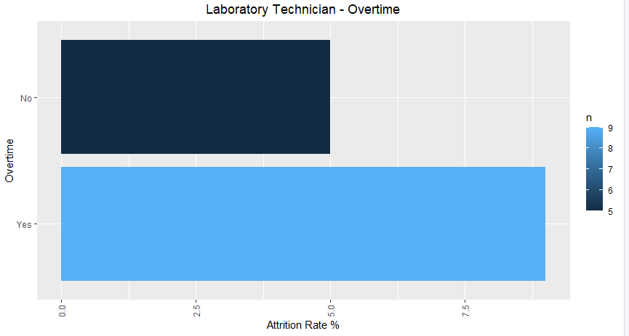
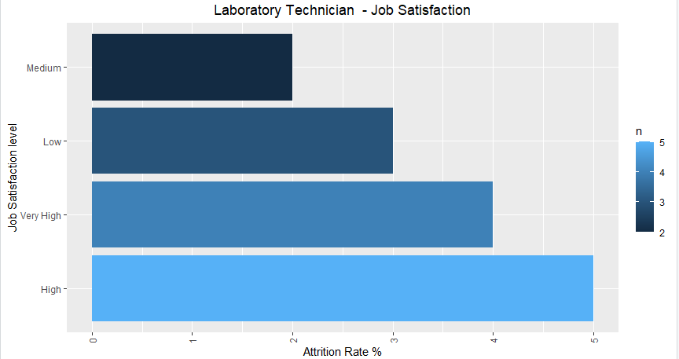
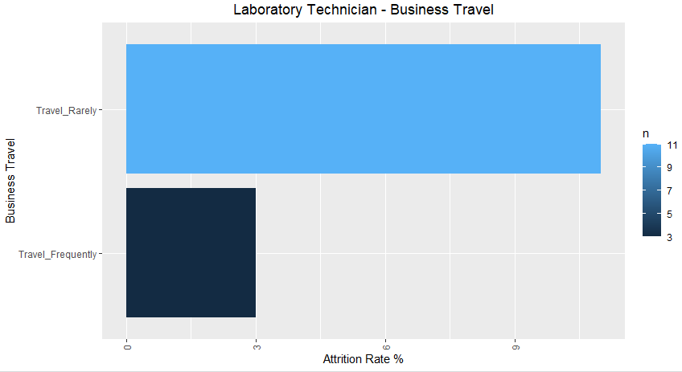
Attrition rate – Work Life Balance – Laboratory Technicians
Monthly income seems to drive attrition for Laboratory Technicians.
Overtime also had some influence .
High job satisfaction has high attrition, which is unexpected, although it may well be that although they have high job satisfaction, there may be other factors driving the attrition.
Business travel, did not have much influence on attrition.

Slide 18
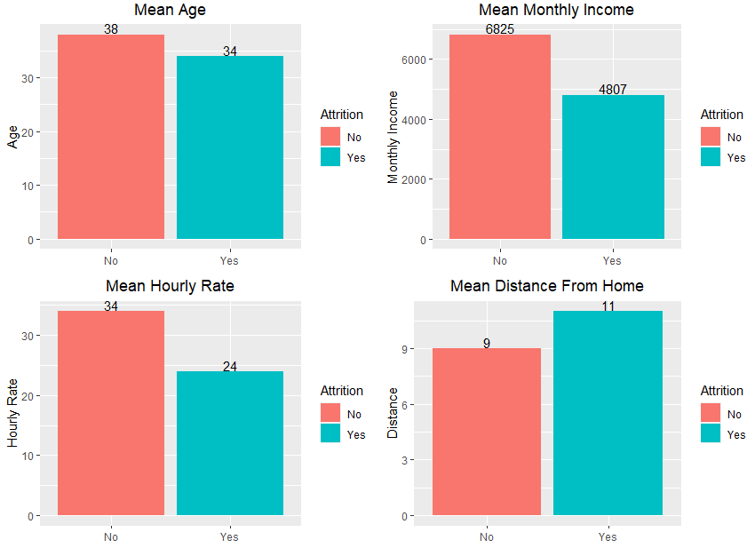
Attrition – Averages
On average, younger people tend to leave the organisation.
Average lower monthly income and hourly rate also have higher attrition.
Greater distance from home increases attrition.

Slide 19
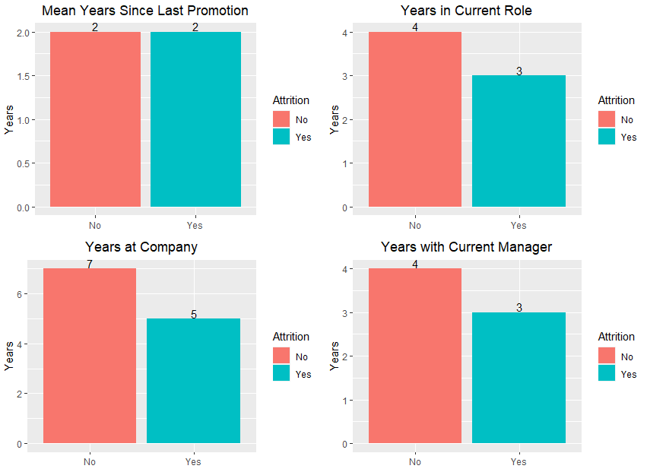
Attrition – Averages
The higher the average years with current manager, years at company and years in current role, the lower attrition rate .
The average years since last promotion don’t seem to have an impact on attrition.

Slide 20
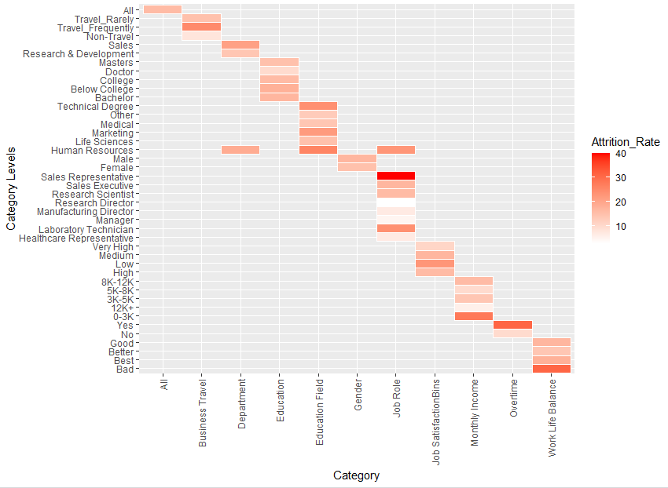
Attrition rates – Heatmap

Slide 21
Power BI dashboard
Importing the data set into power BI allows for simple and powerful analysis of the data and allows us to gain quick and effective insights into the data.
For this dashboard, the data is split into sections for analysis, namely;
Summary page showing the detail that we believe offers an overall view of the expected influencers on attrition.
Demographic and education summary affecting attrition
Employment summary affecting attrition
A decomposition tree
And finally, the data in tabular format for further analysis.

Slide 22
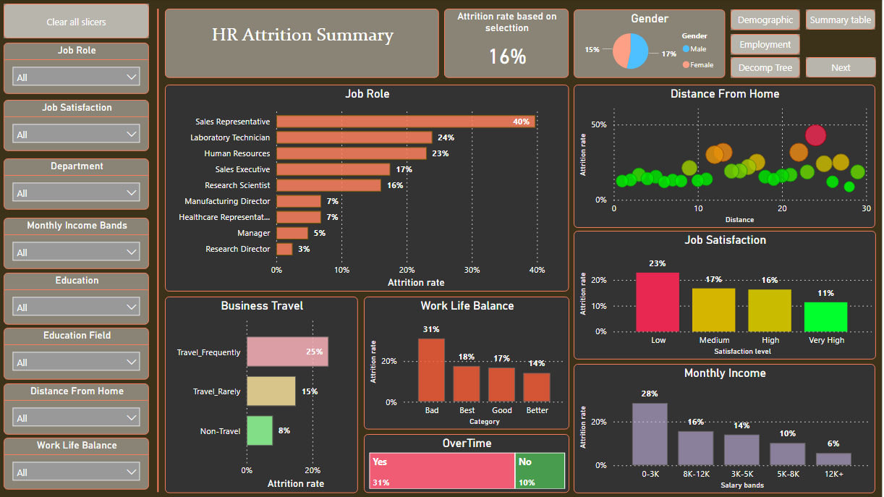
Power BI Dashboard – Attrition summary
From the summary page we can immediately identify the areas affecting attrition;
Sales representative
Further distance from home
Frequent business travel
Bad work life balance
Low job satisfaction
Overtime
Low monthly income
Based on the initial results, we could investigate this further by drilling down into the data using the filters.

Slide 23
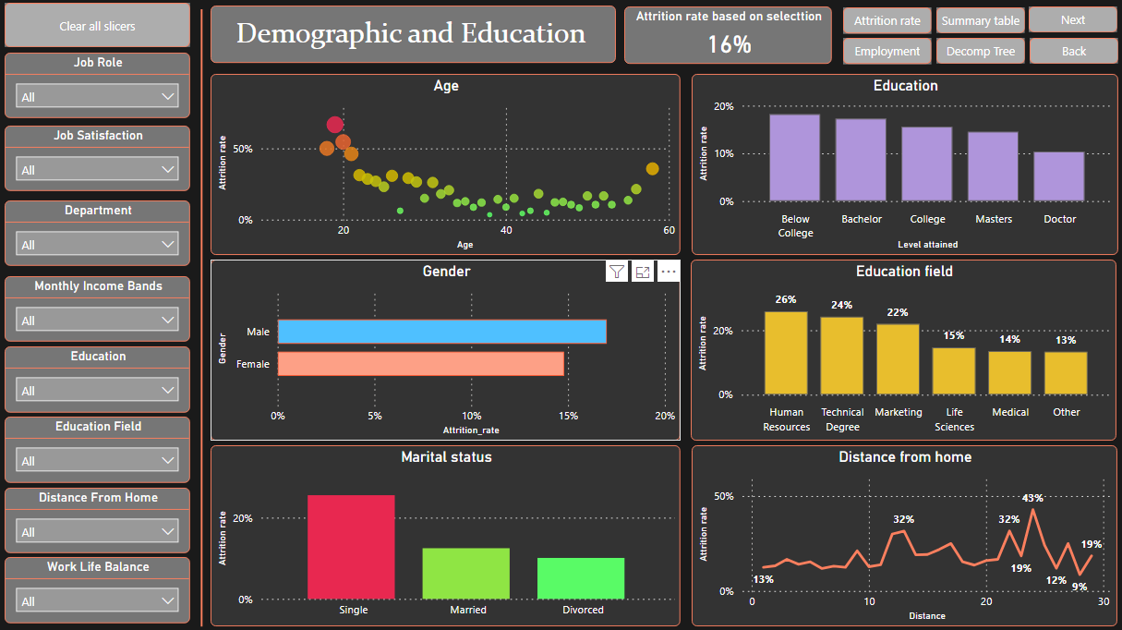
Power BI Dashboard – Demographic and education
From the demographic and education summary page, we can immediately identify the areas affecting attrition;
Younger people tend to leave
More males leave
Single staff have highest attrition
More staff with lower education level tend to leave
In terms of education field, Human resources have the highest attrition rate
Distance from home
Based on the initial results, we could investigate this further by drilling down into the data using the filters.

Slide 24
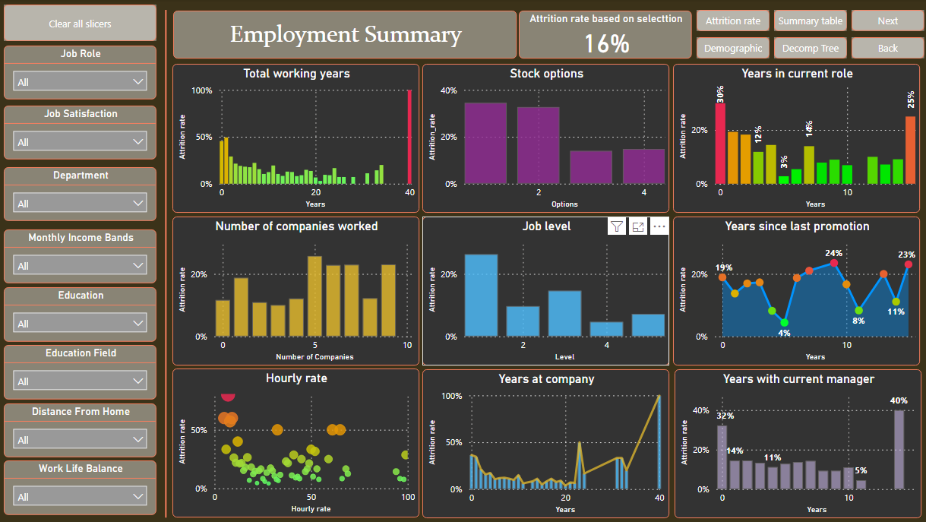
Power BI Dashboard – Employment summary
From the employment summary page, we can immediately identify the areas affecting attrition;
Total working years
Lower hourly rate

Slide 25
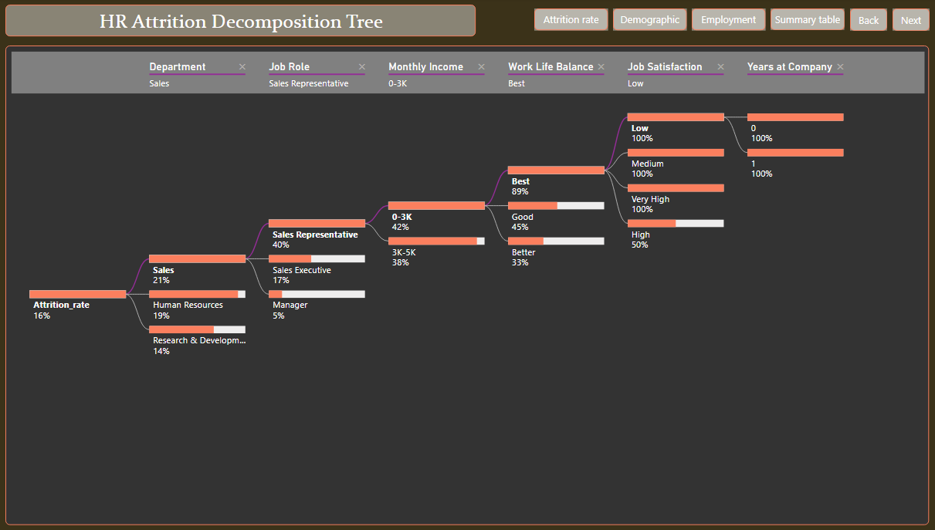
Power BI Dashboard – Decomposition tree

Slide 26
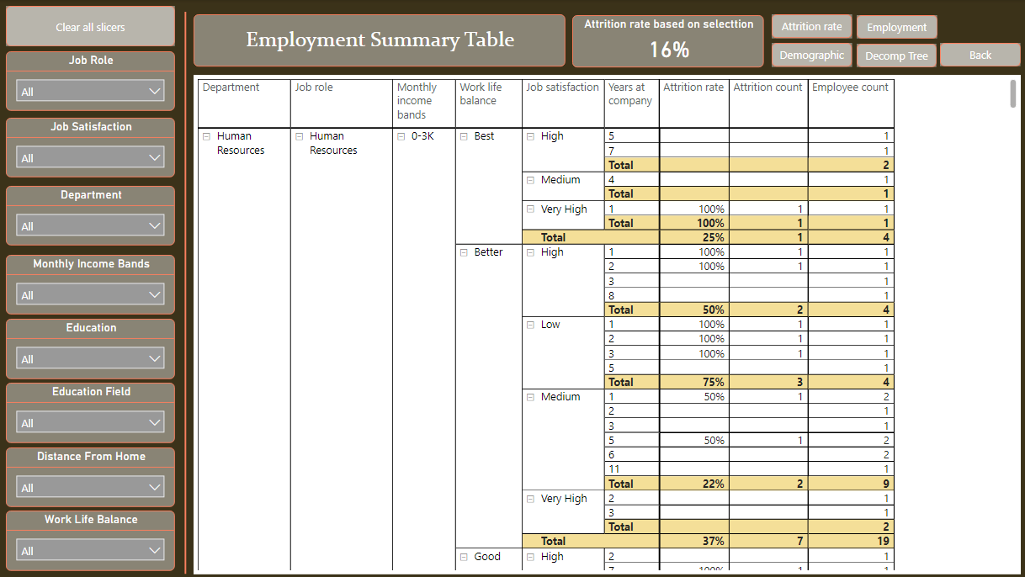
Power BI Dashboard – Summary table

Slide 27
Project Flow – Phase 3 – Predictive modelling
Binary Logistic regression
Run model on original dataset
Split Test and Train data sets
Create test and train split 80/20
Supervised learning models
Binary Logistic Regression
Check for multicollinearity
Moving onto phase 4.
Naïve Bayes
Support Vector Machine
Decision tree – Classification tree
Neural Network
Remove insignificant variables
Find the best threshold
Complete
K-Nearest Neighbours

Slide 28
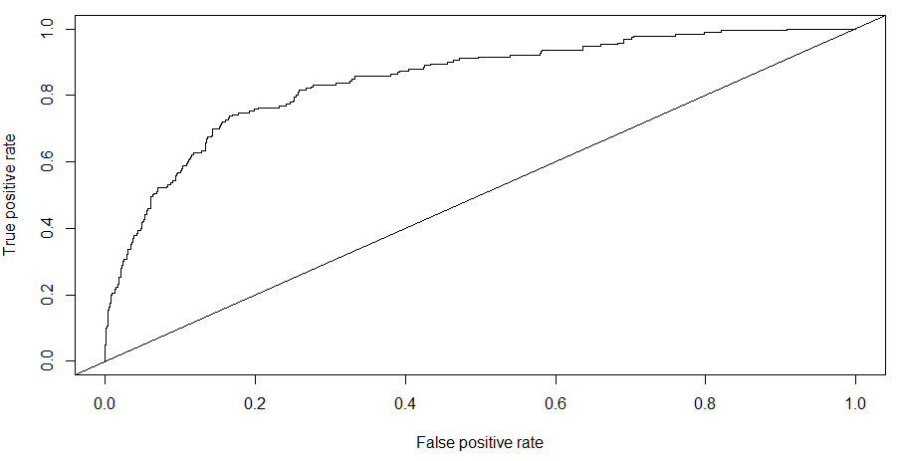
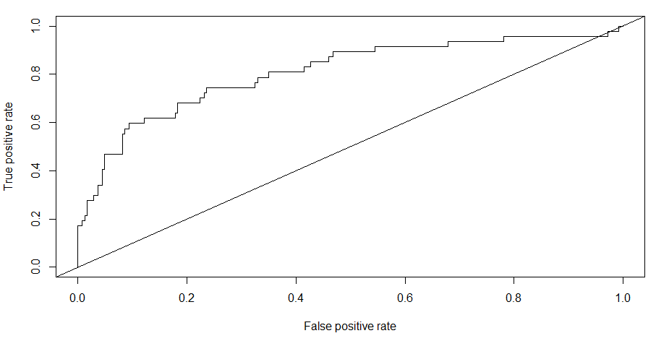
Binary Logistic Regression model
With Binary Logistic Regression, it is possible to model the relationship between a set of independent variables and a binary dependant variable. It is particularly useful when the dependant variable is dichotomous.
Here we can build a model that will help predict the number of staff likely to churn based on significant independent variables.
Training ROC curve
Process:
Run the model on both the test and train datasets.
Generate the ROC curve and compare both outputs. In this case they both seem close.
Get the AUC result, which is 85% for the training set and 80% for the test set. This is a good result.
Get the best threshold, which is 0.21
Generate a confusion matrix for both the test and train data sets.
Training BLR model performance: Sensitivity is 77% and accuracy is 79%
Testing BLR model performance: Sensitivity is 79% and accuracy is 78%
This model has performed well and could be used for the predictions.
Testing ROC curve

Slide 29
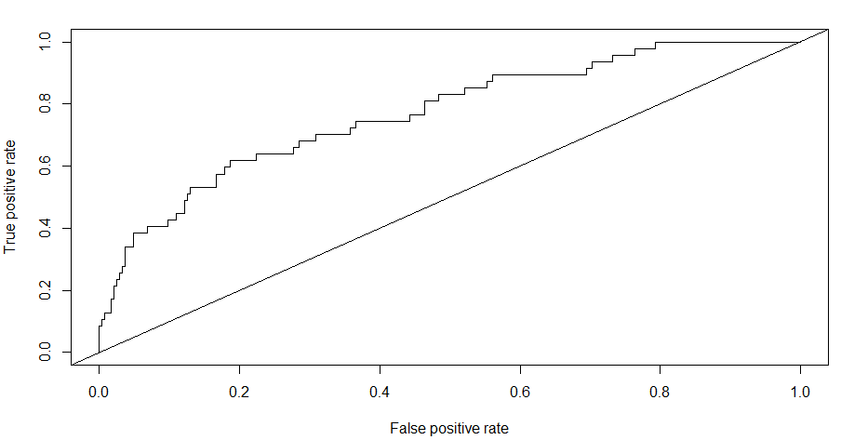
Naïve Bayes model
Naïve Bayes classifier is a supervised machine learning algorithm that is used for classification tasks. It is based on Bayes Theorem and is one of the simplest supervised learning algorithms.
Naïve bayes is highly accurate and quick on large datasets.
Naïve bayes explains the conditional probability of each set of possible causes for a given observed outcome which can be computed from the knowledge of the probability of each cause and the conditional probability of the outcome of each cause.
Naïve Bayes ROC Curve
Process:
Get the AUC result, which is 77%.
Generate a confusion matrix for the test data set.
Model performance: Sensitivity is 64% and accuracy is 74%
This model has not performed as well as the BLR model.

Slide 30
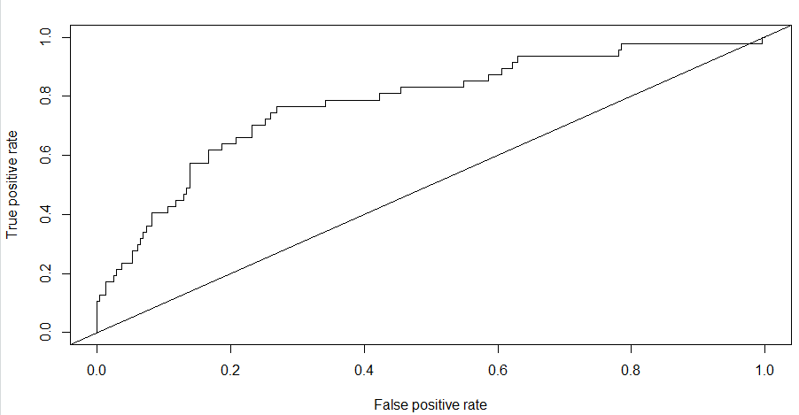
Support Vector Machines
Support Vector machine (SVM) is a supervised machine learning algorithm used to solve classification and regression problems.
They are very good at solving binary classification problems.
SVM works by finding the best possible line, or decision boundary that separates the data points of different data classes.
SVM ROC Curve
Process:
Get the AUC result, which is 82%.
Generate a confusion matrix for the test data set.
Model performance: Sensitivity is 43% and accuracy is 81%
This model has not performed as well as the BLR or Naïve Bayes models.

Slide 31
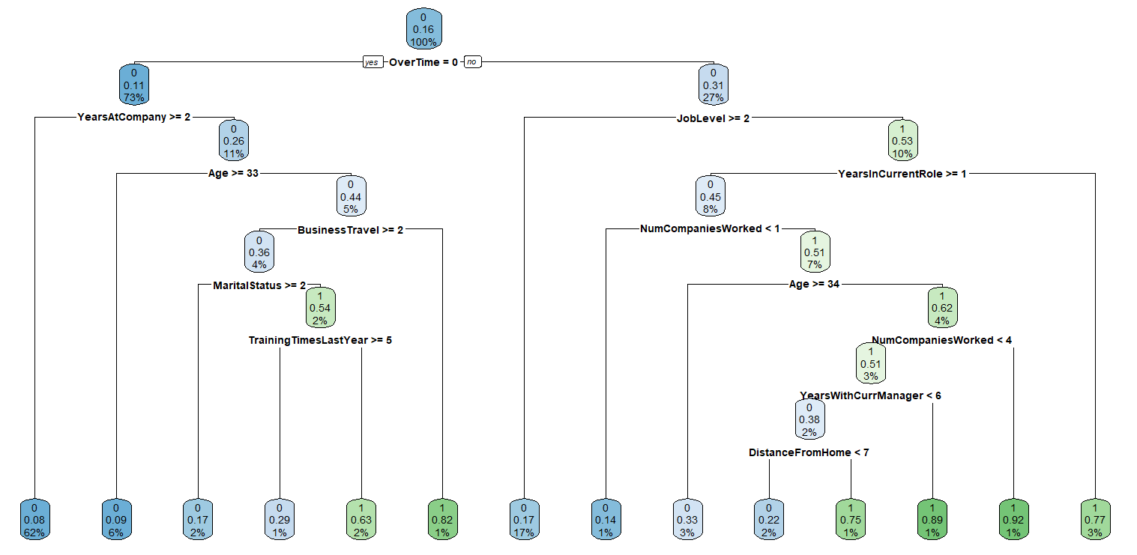
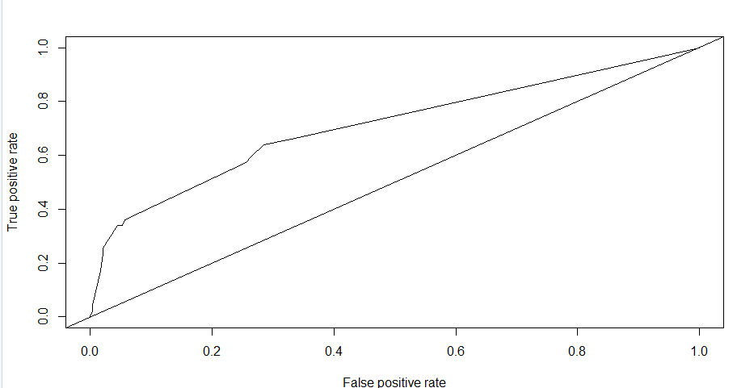
Decision Tree – Classification Tree
Decision trees are non-parametric supervised learning algorithms which can be used for both regression and classification problems. Being a non-parametric, it doesn’t make any assumptions about the population parameters.
Decisions trees have a hierarchical structure starting from a root node and end in a leaf node.
Decision Tree ROC Curve
Process:
Get the AUC result, which is 71%.
Generate a confusion matrix for the test data set.
Model performance: Sensitivity is 34% and accuracy is 86%
This model has not performed as well as the BLR model.

Slide 32
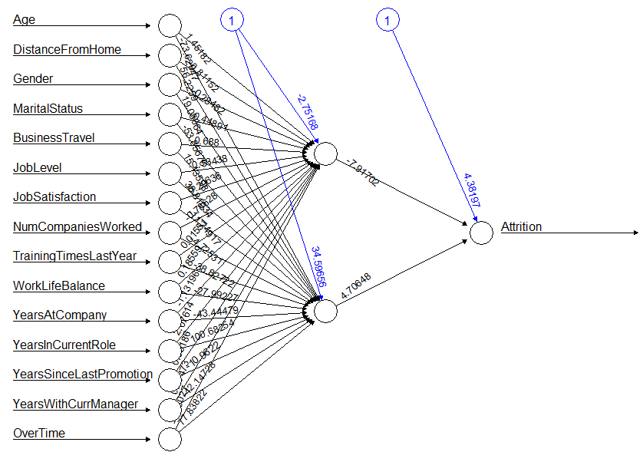
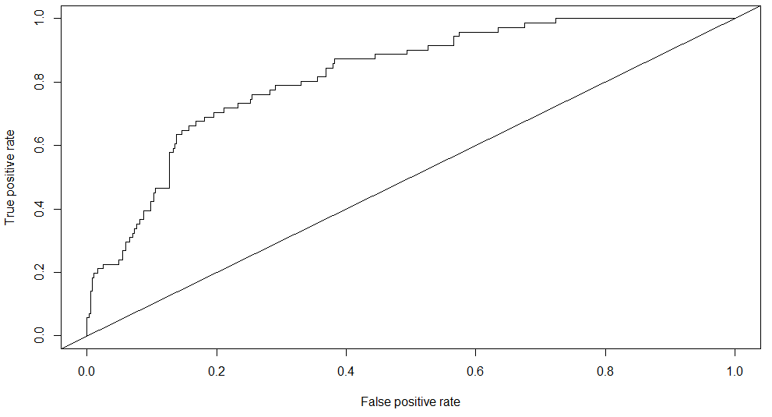
Neural Network
Neural networks are a method in artificial intelligence that teach computers to process data in similar way to the human brain. It uses input and output nodes and hidden layers, which are connected to each other based on their own associated weights and thresholds.
Neural Network ROC Curve
Process:
Get the AUC result, which is 82%.
Generate a confusion matrix for the test data set.
Model performance: Sensitivity is 47% and accuracy is 85%
This model has not performed as well as the BLR model.

Slide 33
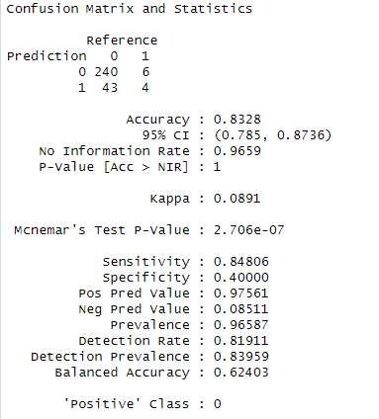
K-Nearest Neighbours
K-Nearest Neighbours (KNN) is a popular and simple supervised non-parametric learning classifier, which use proximity to make predictions or classifications about the grouping of an individual data point.
Process:
Generate a confusion matrix for the test data set.
Model performance: Sensitivity is 85% and accuracy is 84%
Overall, this model has performed the best.

Slide 34
Project Flow – Phase 4 – Text mining and sentiment analysis
Import Text file
Create Corpus
Create word cloud
Perform sentiment analysis
Final summary
Complete
Clean the corpus
Create matrix
Find frequent terms
Find associated words
Create word cloud
Sentiment analysis
Generate trajectory plot
Sentiment analysis bar plot
Frequent terms bar plot

Slide 35
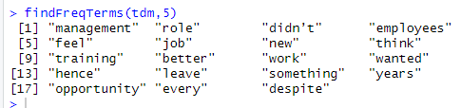
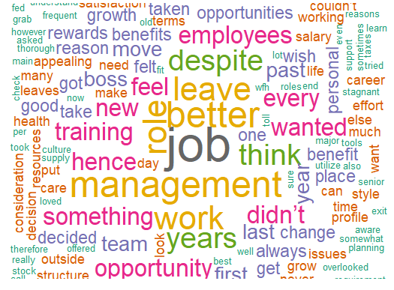
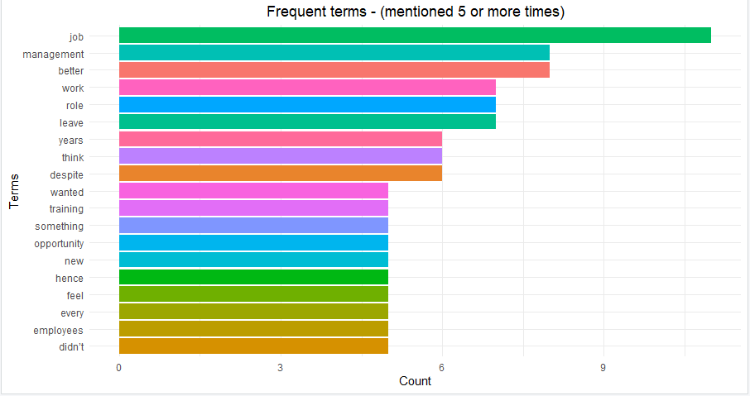
Text mining
Text mining is the process by which unstructured text is transformed into a structured format which allows for identification of meaningful patterns and insights.
Process:
Read the text file and convert to a corpus
Clean the corpus
Change all character to lower case.
Remove all punctuation.
Remove numbers.
Remove stop words.
Find words with a frequency of at least 5.
Generate a word cloud.

Slide 36
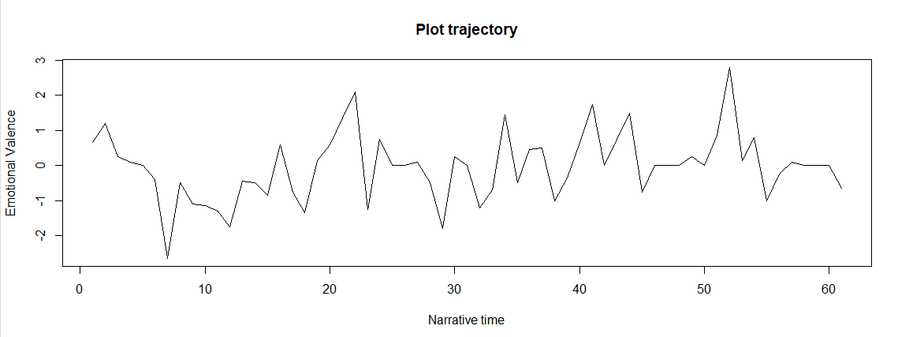
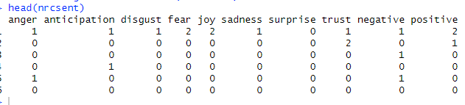
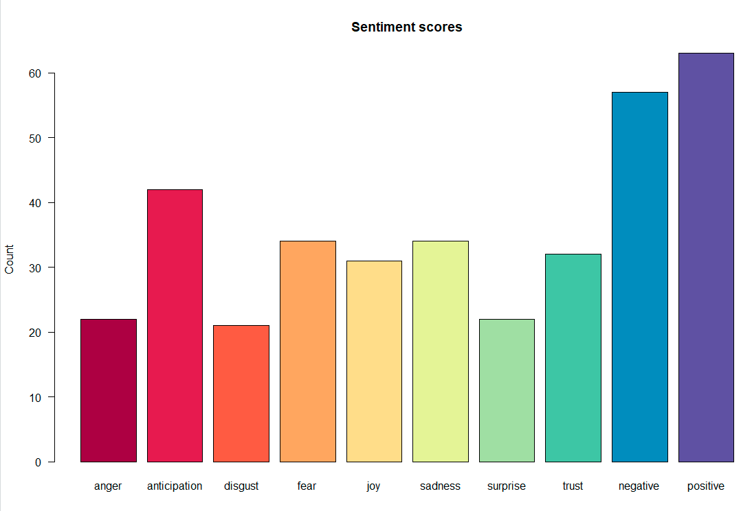
Natural Language Processing - Sentiment analysis
Sentiment analysis helps management understand how the staff may be feeling about the organisation.
Process: (using Syuzhet)
Calculate the sentiment score
Calculate the mean sentiment score
Extract sentiment words and polarity
Get count of words based on polarity
Plot the trajectory
Get sentiment using NRC lexicon
Plot sentiment scores
The sentiment scores do vary although the positive associations do have a higher count. This is further confirmed by the overall positive score in the plot.

Slide 37
Conclusion
Machine learning provides and indispensable role in understanding the intricate workforce dynamics that drive employee attrition. Utilising predictive modelling, we have been able to identify crucial factors affecting attrition and the ability to predict turnover within an organisation.
The effectiveness of the models used in this analysis are further validated by the impressive AUC scores in the ROC analysis.
The sensitivity and accuracy scores further add weight to the effectiveness of the model.
The model provides the organisation with the opportunity to identify areas that are more likely to drive attrition, such as monthly salary, hourly rate and distance from home, and to focus on improving these areas and in so doing, reduce attrition.

